Slide 1
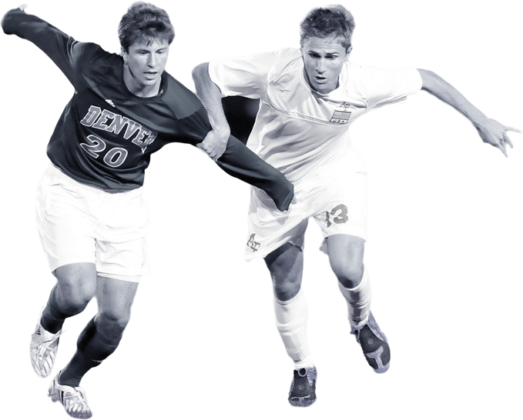

EU Soccer Betting
DMBI Assignment #2

Slide 2



Agenda
01
Introduction & Business Goal
02
Dataset & ETL Procedure
03
Analysis Services (SSAS)
04
Visualizations

Slide 3
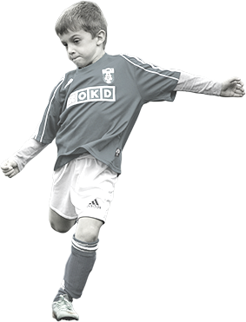
Introduction & Business Goal

Slide 4
Introduction
2019
“People should not gamble/bet”
Market size of the sports betting and lottery sector
220,56 b.
- Not an ethical/philosophical statement
Predicting sports results and making a bet on the outcome is known as sports betting. The frequency and types of sports betting varies according to culture and country of residence, with most bets being placed on amateur and professional levels of football/soccer, American football, basketball, baseball, hockey, track cycling, car racing, mixed martial arts, and boxing.
Owning or investing on a betting/gambling company can be very profitable. If sport betting companies gain large profits, it is due to the existence of betters who bet their money on their odds and of course they lose their money. And sometimes an enormous amount of it.
2020
172.89 billion dollars, due to COVID-19 pandemic restrictions
21.6%
12.6%
2021
194.63 billion dollars, as the sector witnessed a recovery in demand
Source: https://www.statista.com/statistics/1186240/sports-betting-and-lottery-industry-market-size-global/

Slide 5

Business Goal
Not Gambling
Gambling
Persuade people not to gamble/bet
Take advantage of big data
People should earn their money from their regular jobs. Gambling or betting can lead to addiction.
One solution to this problem and the most efficient one is to persuade betters not to bet again in their life.
Due to the aspect of “easy money” and the fun of being lucky (rarely), it is a rather difficult case for someone to turn the most efficient solution to feasible.
Big data that are flooded everywhere in our “web universe”. Someone could collect them and exploit them, making use of
databases to store them and analyze them,
and statistics to extract some derivatives making use of descriptive, predictive, or even prescriptive statistics.
In that case, he/she would not avoid losing some of his money but could minimize that amount as close to zero as possible.

Slide 6
Dataset & ETL Procedure

Slide 7
Timeline of ETL Procedure
2
4
Drivers
Transform
Download the required drivers (SQLite db file)
Clean the data, convert data types, deduplicating, etc.
1
3
5
Download
Extract
Load
Find the dataset and download it
Create the Schema and intermediate (staging) tables and load the initial data in the staging tables
Data is loaded “securely” into dimension and fact tables making business-ready data available

Slide 8
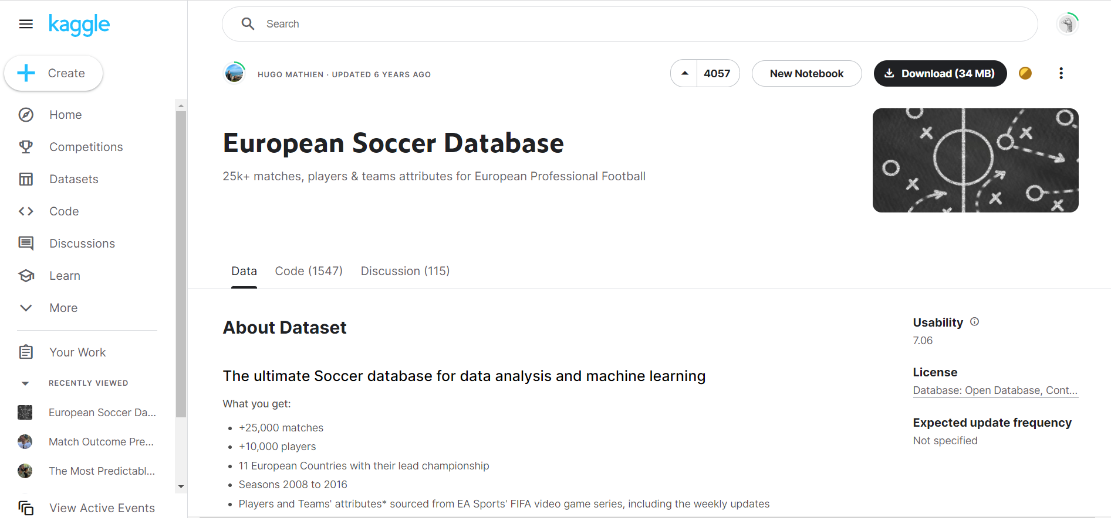
Download Dataset
Source: https://www.kaggle.com/datasets/hugomathien/soccer

Slide 9
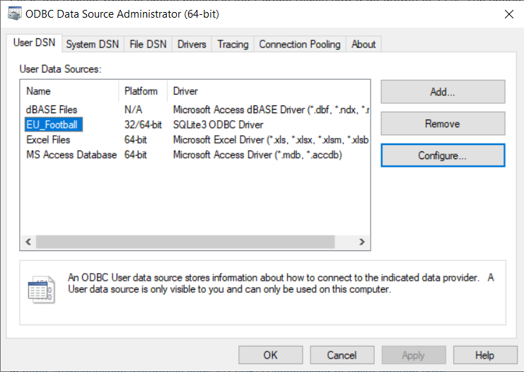
Drivers

Slide 10
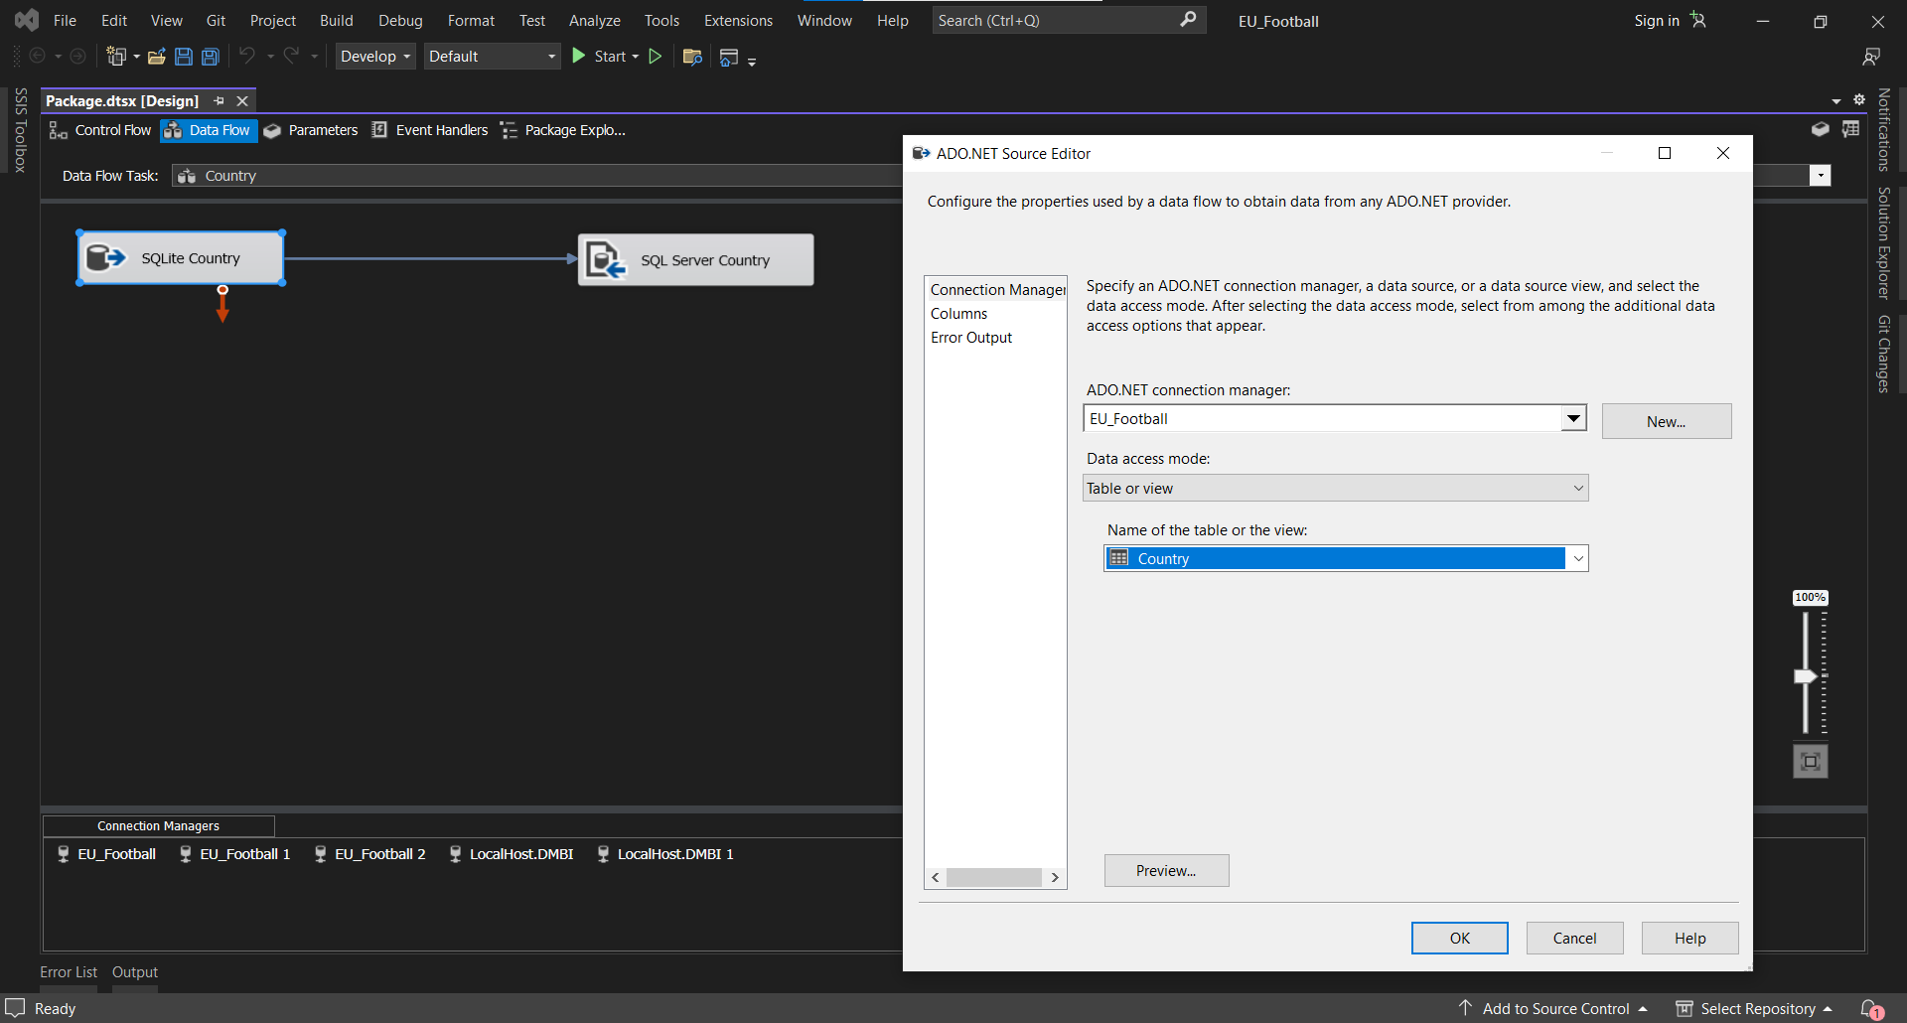
Extract = Various
Data Flow Tasks

Slide 11
Transform
Converted all NVARCHAR(MAX) columns to VARCHAR because SQL Server treats the first case as TEXT values and constraints UNIQUE KEYS could not be added
Convert Datatypes
Identity Primary Keys
Added IDENTITY PRIMARY KEYS to Dimension Tables
Columns (no ID) to Dimensions
There were some columns that should be Dimensions and a separate table with an id did not exist. So, we took advantage of
the Analytic Function “ROW_NUMBER() OVER(ORDER BY column)”.
Cleaning
- Wrong character values → N/A
- Duplicate name values with different IDs → Updated to correct name values and deleted where truly was duplicate
Used UNPIVOT Relational Operator to transform 30 columns of a table to column values discarding the rows that contained null values for all columns

Slide 12
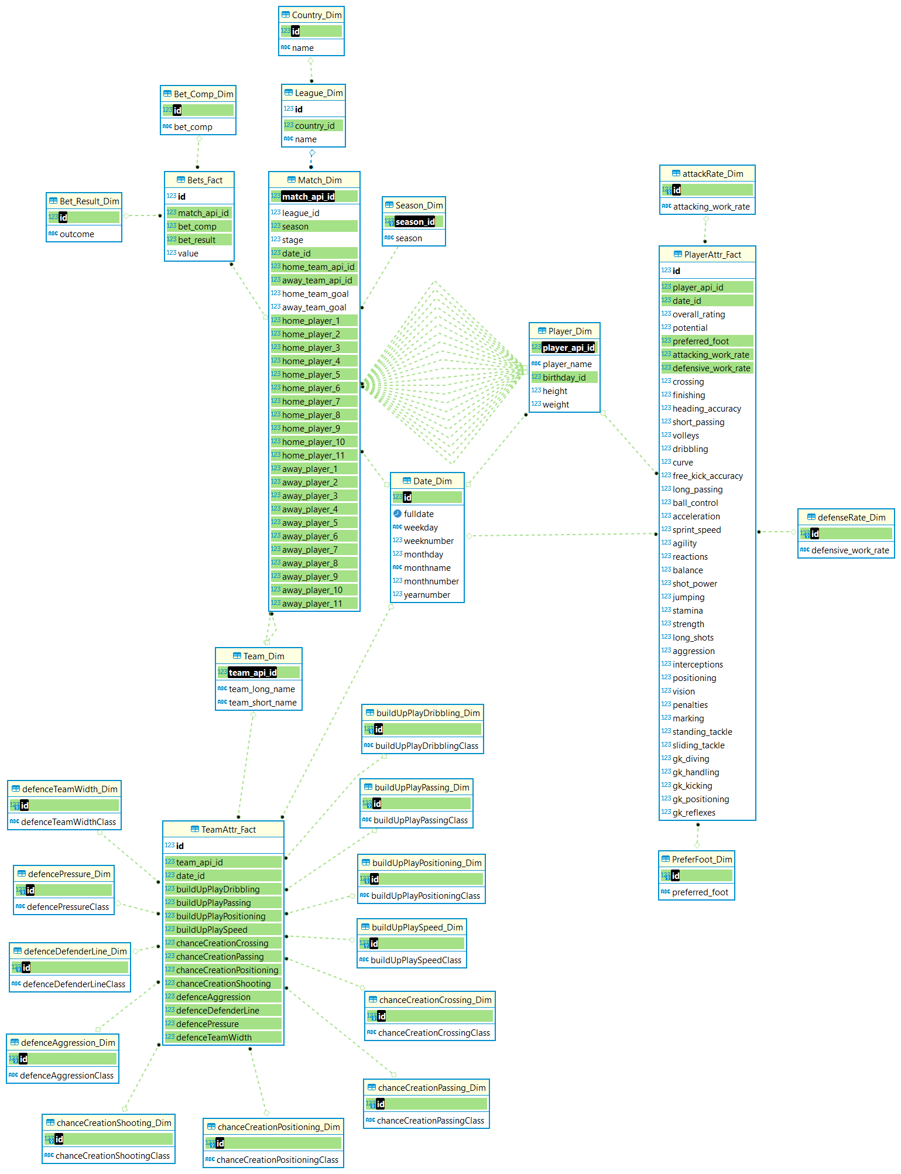
Schema

Slide 13
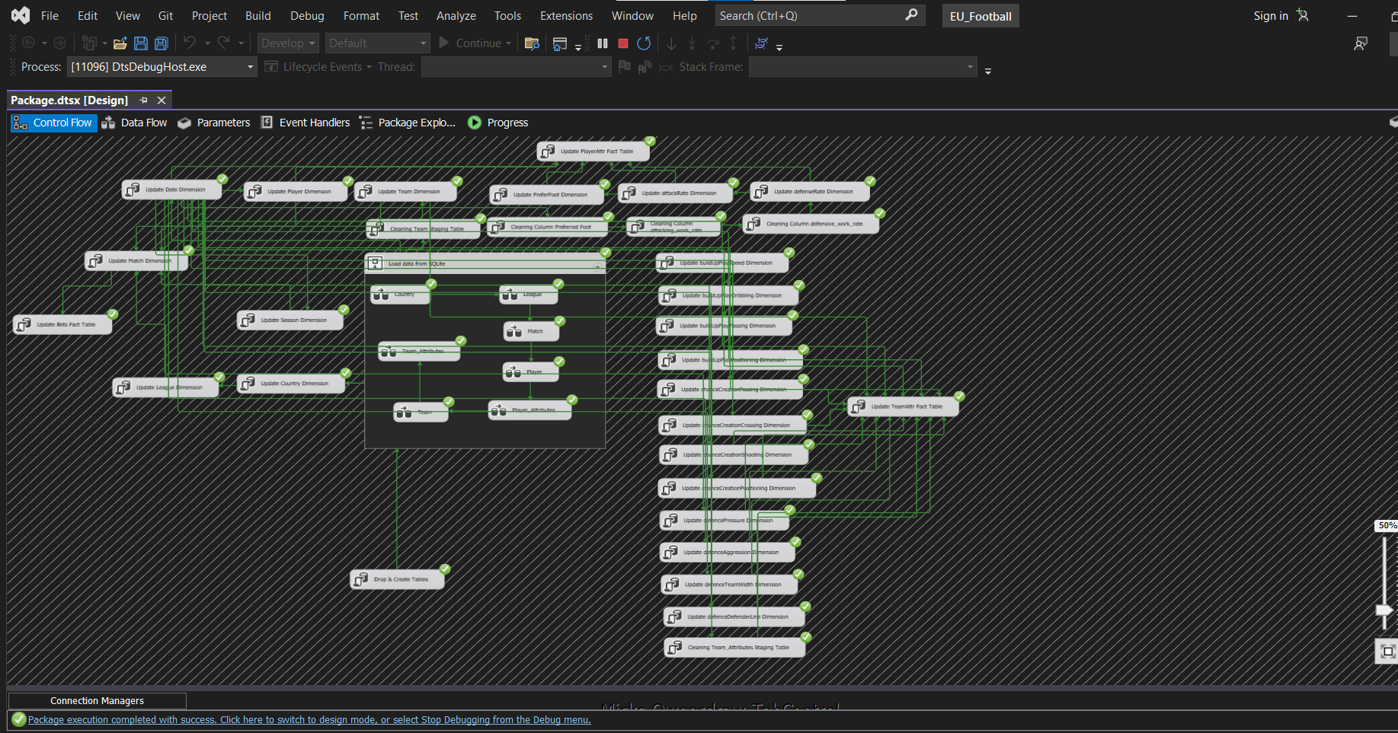
Load
“MERGE INTO
WHEN NOT MATCHED THEN INSERT VALUES”

Slide 14
SQL Server
Analysis Services

Slide 15
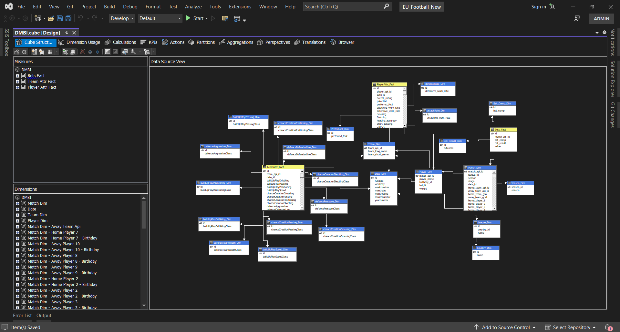
SQL Server Analysis Services (OLAP Cube)

Slide 16
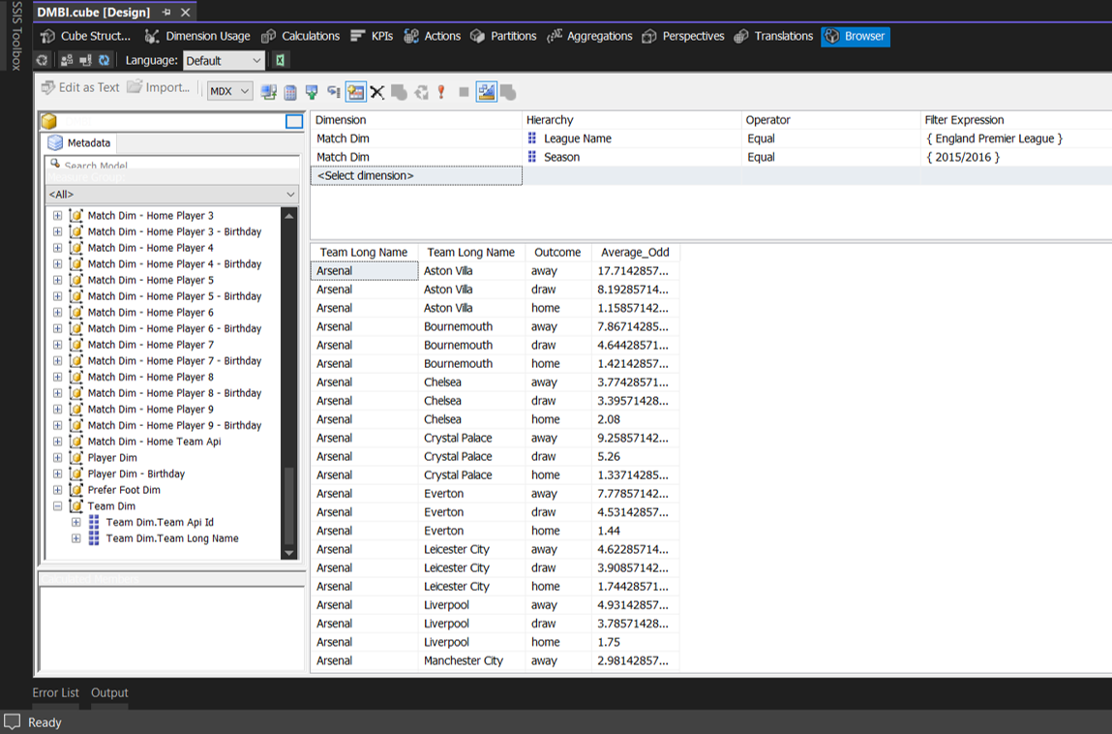
OLAP Report
(Calculated Measure)

Slide 17
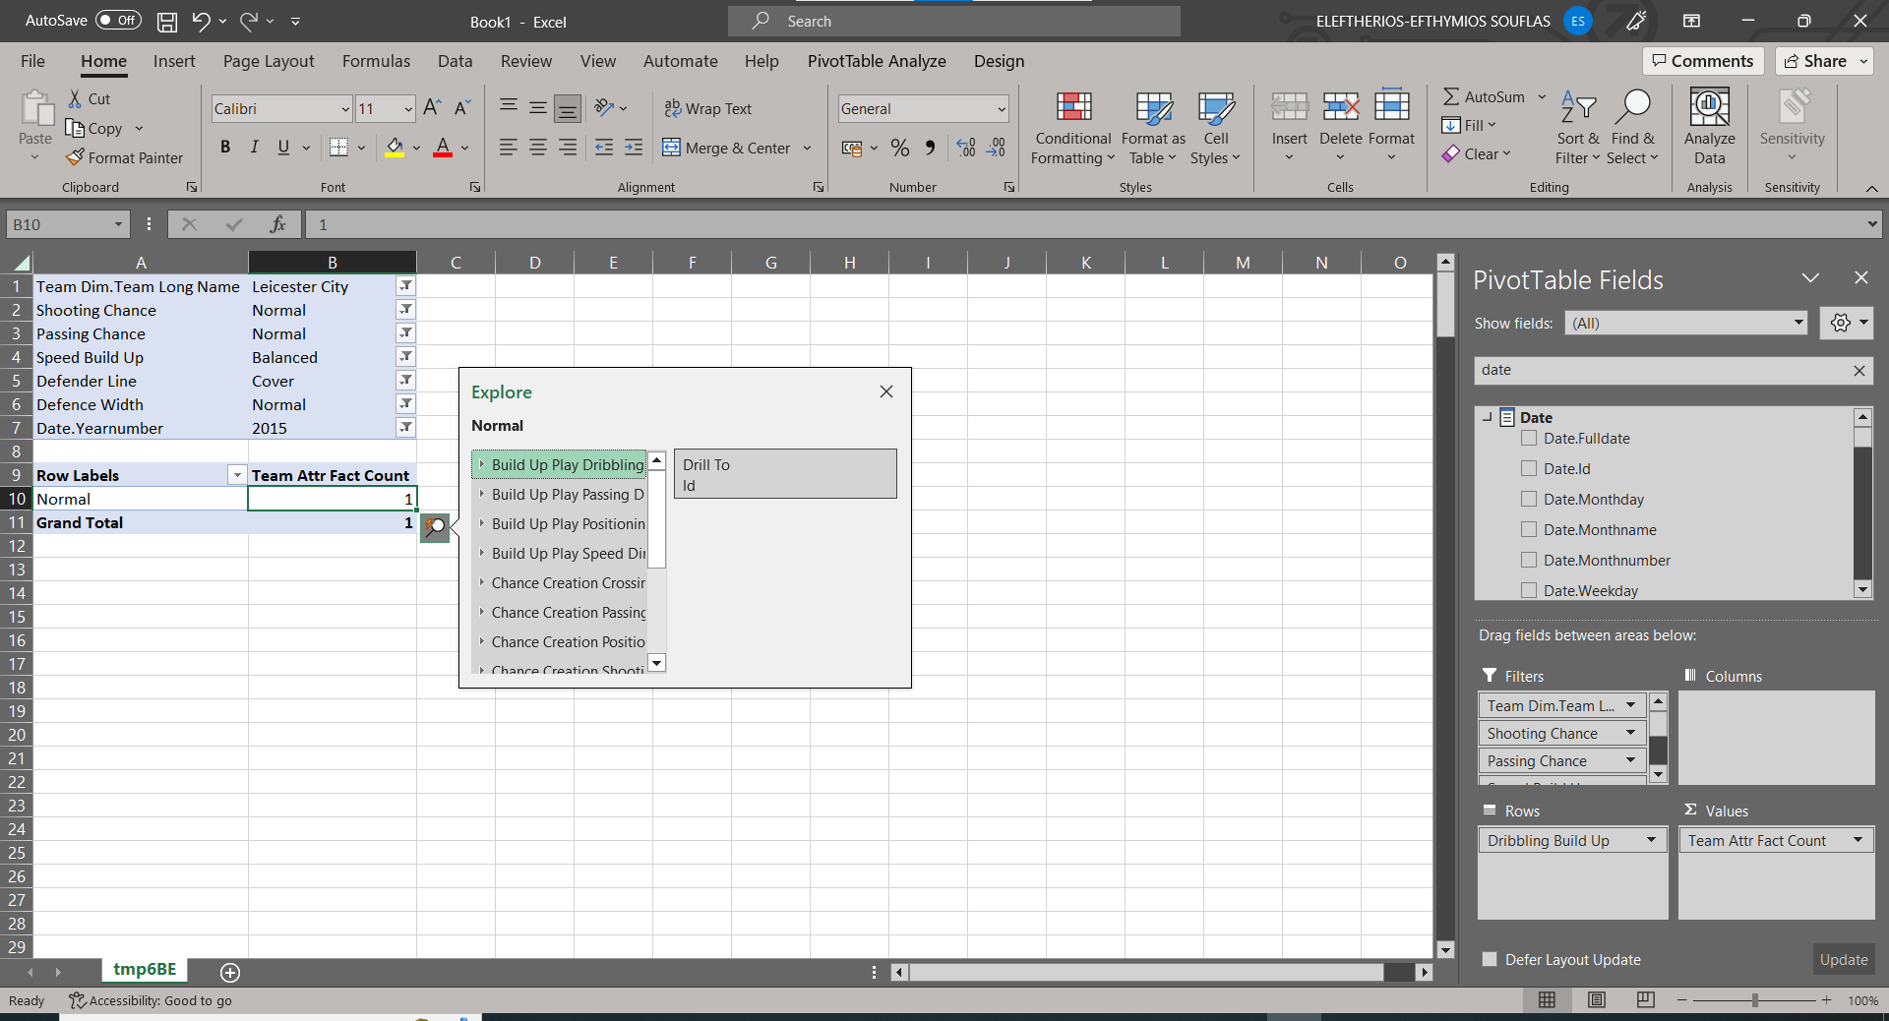
OLAP Report
(Drill-Through Action)

Slide 18
Visualizations

Slide 19
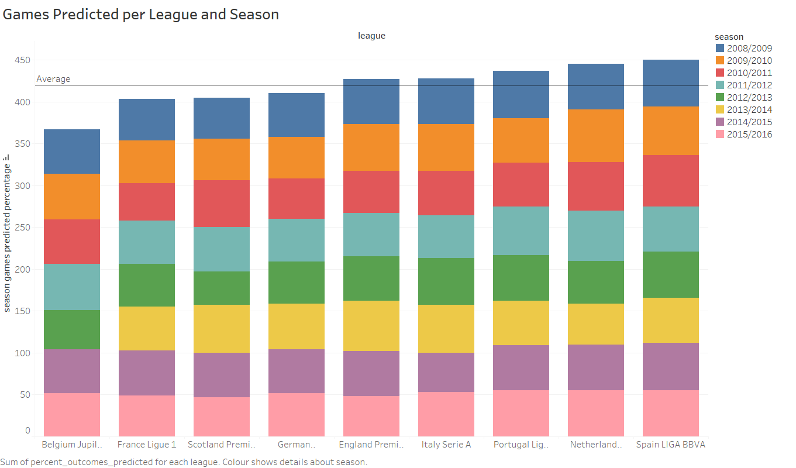
Visualizations (Outcomes Predicted per League and Season)

Slide 20
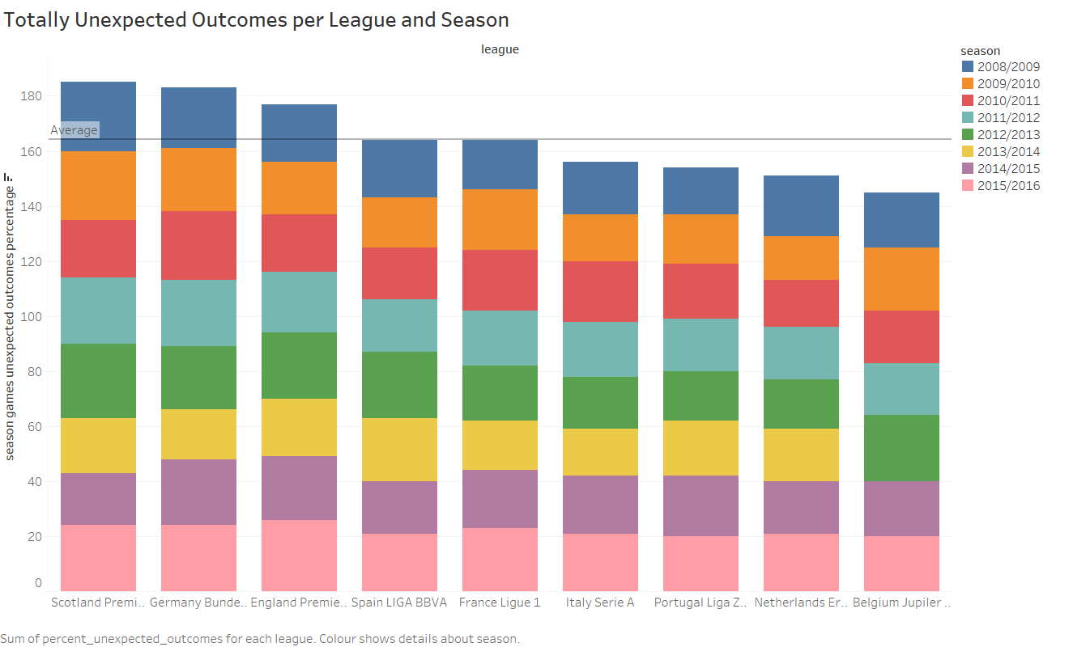
Visualizations (Unexpected Outcomes per League and Season)

Slide 21
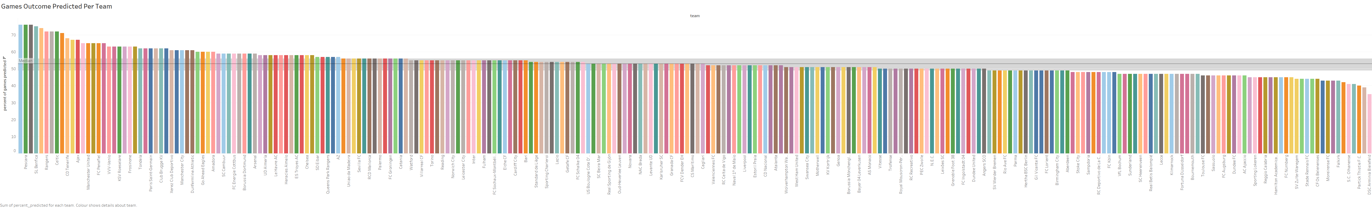
Visualizations (Unexpected Outcomes per League and Season)

Slide 22
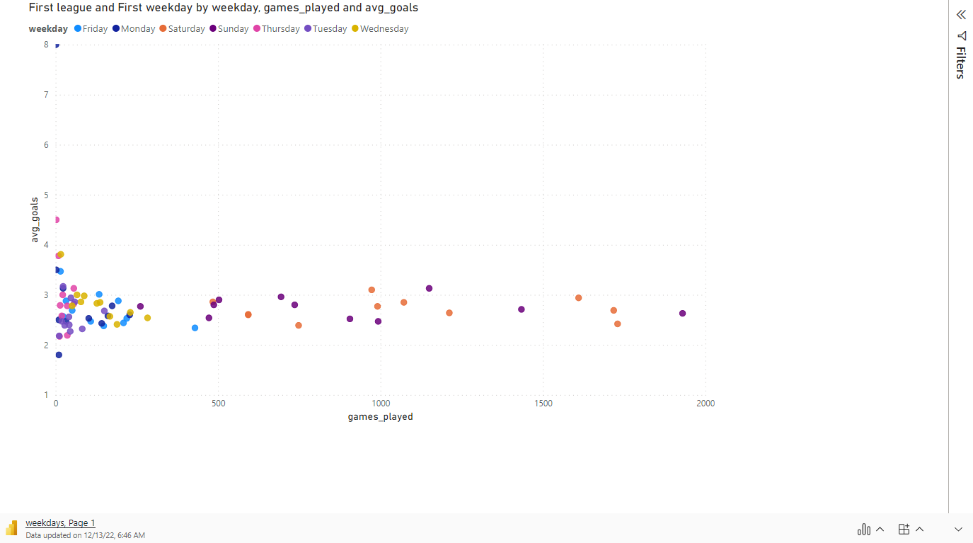
Visualizations (Results per Weekday and League)

Slide 23
Questions ???

Slide 24
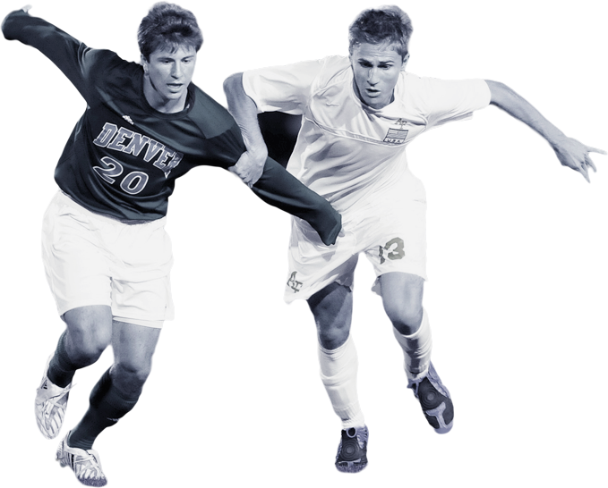

Thank You
Gkouma Konstantina (f2822208)
Souflas Eleftherios-Efthymios (f2822217)

